Slide 1
Data Modelling, Management & Governance CIS108-6
Clouds Computing and Distributed Data Systems
Gangmin Li
(Office hours: 13:00-17:00 every Friday)

Slide 2
Outline
Clouds Computing (NIST definition)
5 essential characteristics,
3 service models, and
4 deployment models
Distributed database and distributed database Management Systems

Slide 3
Clouds Computing
Provide physical solution for IT resources demands (commutation and storage)

Slide 4
Clouds computing

Slide 5
Definition
“Cloud computing is a model for enabling convenient, on-demand network access to a shared pool of configurable computing resources (e.g., networks, servers, storage, applications, and services) that can be rapidly provisioned and released with minimal management effort or service provider interaction. This cloud model promotes availability and is composed of five essential characteristics, three service models, and four deployment models.”
– (NIST, USA)

Slide 6
In My Opinion
Cloud computing is a paradigm of computing, a new way of thinking about IT industry but not any specific technology.
Central ideas
Utility Computing
SOA - Service Oriented Architecture
Properties and characteristics
High scalability and elasticity
High availability and reliability
High manageability and interoperability
High accessibility and portability
High performance and optimization
Enabling techniques
Hardware virtualization
Parallelized and distributed computing
Web service

Slide 7
Why Clouds?
Concept of clouds is around 2000, but Grid computing, sharing and rent computation is long ago. Bask to 1960 …
Resources demand vs Resources waste (sharing)
Rent (PAYG) idea
Ubiquitous computing: Anywhere, anytime, …
Pervasive computing
Unitality computing
On-demand computing

Slide 8
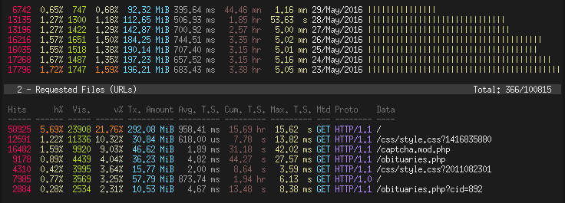
Applications
Web data analysis
Scientific and economic big data analyses

Slide 9
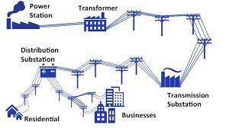
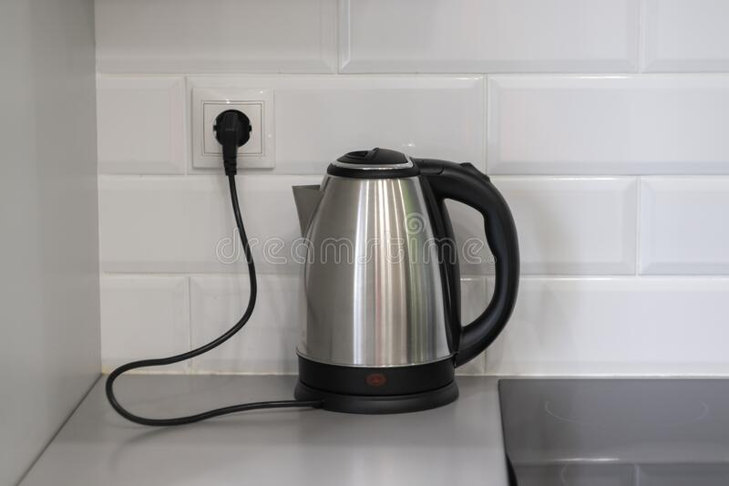
Grid Computing
Grid computing is a group of networked computers that work together as a virtual supercomputer to perform large tasks, such as analysing huge sets of data or modelling complex systems like aerodynamics, fluid dynamics, whether systems.

Slide 10
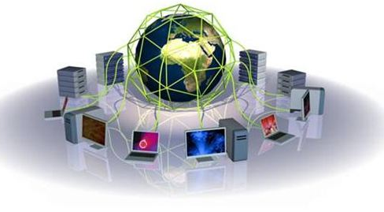
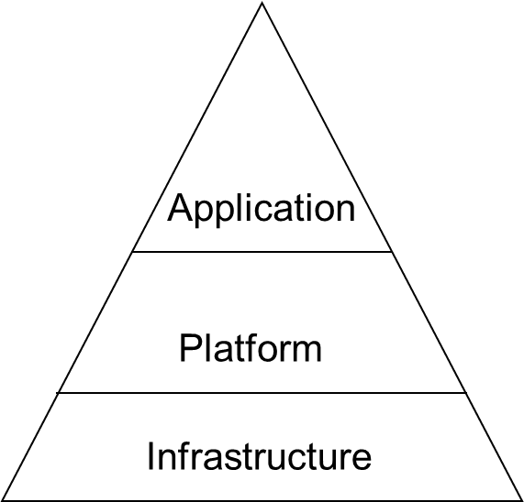
Grid computing
Mainframe → PC → Cloud
Utility services

Slide 11
Three cornerstones of Grid computing
Decentralised, local, and global coordination of resources such as computer clusters, data analytics, mass storage, and databases.
Standardised, open interfaces (nodes) and middleware (protocols or protocol bundles) that connect computing units to the main grid and distribute tasks.
Provision of non-trivial quality-of-service (QoS) to optimally distribute data streams and ensure constant scalability and reliable data transfer under high computational demands.

Slide 12
Clouds vs. Grid
Grid computing distributes processes non-centrally to coupled resources, cloud computing uses centrally hosted cloud servers.

Slide 13
Advantages of Clouds
Lower cost
hw/sw/maintenance
Applications as components
No upfront investment in software/hardware infrastructure
No need to build a proprietary infrastructure for a peak load
Flexible scalability
Higher utilization.
Improved reliability.

Slide 14
5 Essential characteristics
Rapid elasticity. Capabilities can be rapidly and elastically provisioned, in some cases automatically, to quickly scale out and rapidly released to quickly scale in. To the consumer, the capabilities available for provisioning often appear to be unlimited and can be purchased in any quantity at any time.
On-demand self-service. A consumer can unilaterally provision computing capabilities, such as server time and network storage, as needed automatically without requiring human interaction with each service’s provider.
Measured Service. Cloud systems automatically control and optimize resource use by leveraging a metering capability at some level of abstraction appropriate to the type of service (e.g., storage, processing, bandwidth, and active user accounts). Resource usage can be monitored, controlled, and reported providing transparency for both the provider and consumer of the utilized service.
*NIST Definition of Cloud Computing”, Peter Mell and Tim Grance, Information Technology Laboratory, 10-7-09

Slide 15
5 Essential characteristics
Broad network access. Capabilities are available over the network and accessed through standard mechanisms that promote use by heterogeneous thin or thick client platforms (e.g., mobile phones, laptops, and PDAs).
Resource pooling. The provider’s computing resources are pooled to serve multiple consumers using a multi-tenant model, with different physical and virtual resources dynamically assigned and reassigned according to consumer demand. There is a sense of location independence in that the customer generally has no control or knowledge over the exact location of the provided resources but may be able to specify location at a higher level of abstraction (e.g., country, state, or datacenter). Examples of resources include storage, processing, memory, network bandwidth, and virtual machines.

Slide 16
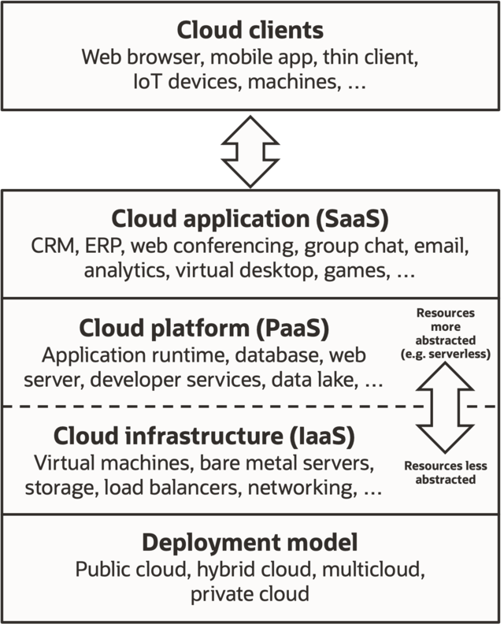
3 Service models
Software as a Service (SaaS)
Platform as a Service (PaaS)
Infrastructure as a Service (Iaas)

Slide 17
SaaS
Software as a Service (SaaS) is the delivery of applications as a service, probably the version of cloud computing that most people are used to on a day-to-day basis. The underlying hardware and operating system is irrelevant to the end user, who will access the service via a web browser or app; it is often bought on a per-seat or per-user basis.
Examples
Gmail, Google Apps
SalesForce.com
Youtube
Facebook

Slide 18
PaaS
Delivers a platform rather than a service
API for developers
Services are limited by APIs capabilities
Examples
Google App Engine
Mosso (Rackspace)
Server platforms on demand

Slide 19
IaaS
Computer hardware (typically set up as a grid for massive horizontal scalability)
Physical footprint/hardware
Client has control over operating system, applications, firewalls)
Client has no control over underlying cloud infrastructure
Examples: physical or virtual servers, storage and networking.

Slide 20
4 Deploy models
HPC cloud
Big data cloud

Slide 21
4 Deploy models: Private Clouds
Private cloud: A private cloud refers to cloud computing resources used exclusively by a single business or organization.
A private cloud can be physically located on the company’s on-site data center.
Some companies also pay third-party service providers to host their private cloud.
A private cloud is one in which the services and infrastructure are maintained on a private network.

Slide 22
4 Deploy models: Public Clouds
Public cloud: Public clouds are owned and operated by a third-party cloud service providers, which deliver their computing resources, like servers and storage, over the Internet.
Microsoft Azure is an example of a public cloud. With a public cloud, all hardware, software, and other supporting infrastructure is owned and managed by the cloud provider.
You access these services and manage your account using a web browser.

Slide 23
4 Deploy models: Hybrid
Hybrid cloud: is a composition of a public cloud and a private environment, such as a private cloud or on-premises resources, offering the benefits of multiple deployment models.
Hybrid cloud can also mean the ability to connect collocation, managed and/or dedicated services with cloud resources.
A hybrid cloud service crosses isolation and provider boundaries so that it can't be simply put in one category of private, public, or community cloud service.
It allows one to extend either the capacity or the capability of a cloud service, by aggregation, integration or customization with another cloud service.

Slide 24
4 Deploy models: Community
Community cloud: is a composition of a public cloud and a private environment, such as a private cloud or on-premises resources, offering the benefits of multiple deployment models.
Hybrid cloud can also mean the ability to connect collocation, managed and/or dedicated services with cloud resources.
A hybrid cloud service crosses isolation and provider boundaries so that it can't be simply put in one category of private, public, or community cloud service.
It allows one to extend either the capacity or the capability of a cloud service, by aggregation, integration or customization with another cloud service.

Slide 25
Foundational Elements of Cloud Computing
Virtualization
Grid technology
Service Oriented Architectures
Distributed Computing
Broadband Networks
Browser as a thin client or service interface

Slide 26
Examples
AWS: Amazon web services
Amazon EC2
Amazon S3
Amazon SimpleDB
Amazon SQS
Amazon CloudFront
Elastic IP
Google App Engine:
App Engine (https://cloud.google.com/)
google Colab. (https://colab.research.google.com/)
Microsoft:
Azure.

Slide 27
Distributed Systems
Unprecedent Big Data demand new approaches for storage and management

Slide 28
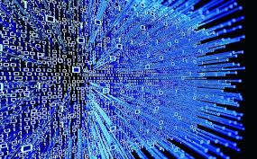
Big Data

Slide 29
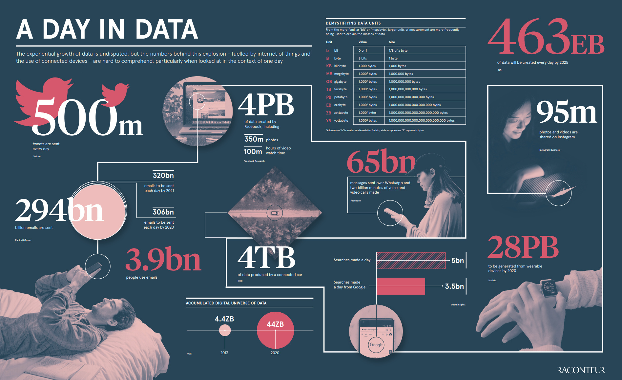
data we generate a day

Slide 30
Big Data challenge
Big Data: We have a lot of data that we need to store more than can fit on any one computer
Large Computation: Computing all the queries takes a very long time
Fault tolerance: We don’t want our whole system to go down if our database hardware fails or there is a network error

Slide 31
Can we make computer bigger?
Small
Big

Slide 32
Fault tolerance

Slide 33
Distributed (Processing) Idea

Slide 34
Example of Big data platform: Hadoop

Slide 35
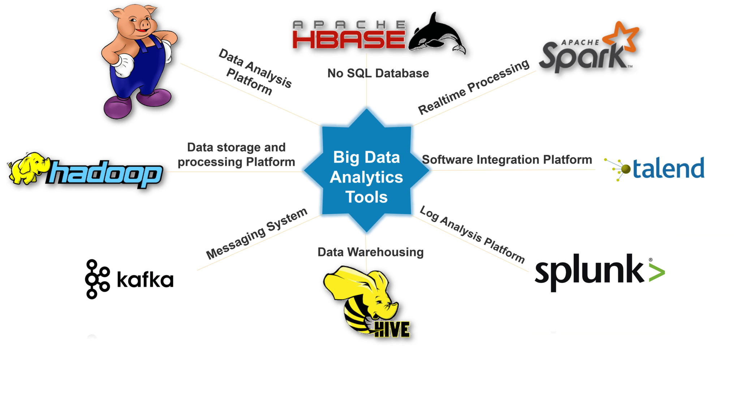
BDA Tools
These are some tools used for Big Data Analytics: Hadoop, Pig, Apache HBase, Apache Spark, Talend, Splunk, Apache Hive, Kafka.

Slide 36
Hadoop

Slide 37
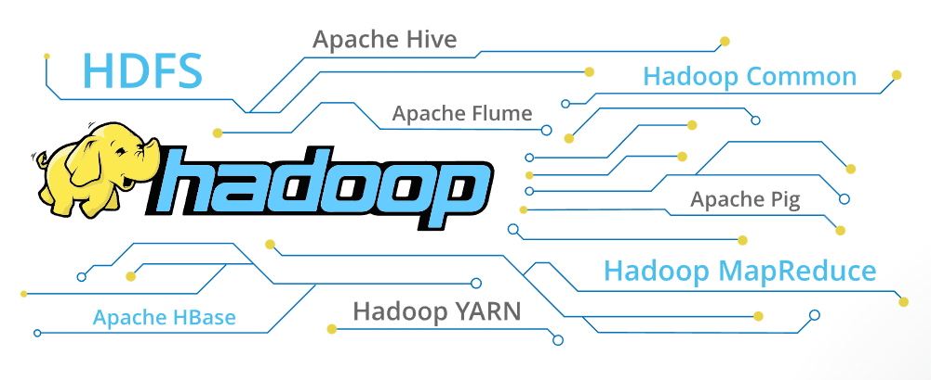
Hadoop components and ecosystem

Slide 38
Core Components of Hadoop

Slide 39
HDFS

Slide 40
How files are stored?

Slide 41
How Files are Stored?

Slide 42
How Files are Stored?

Slide 43
How Files are Stored?

Slide 44
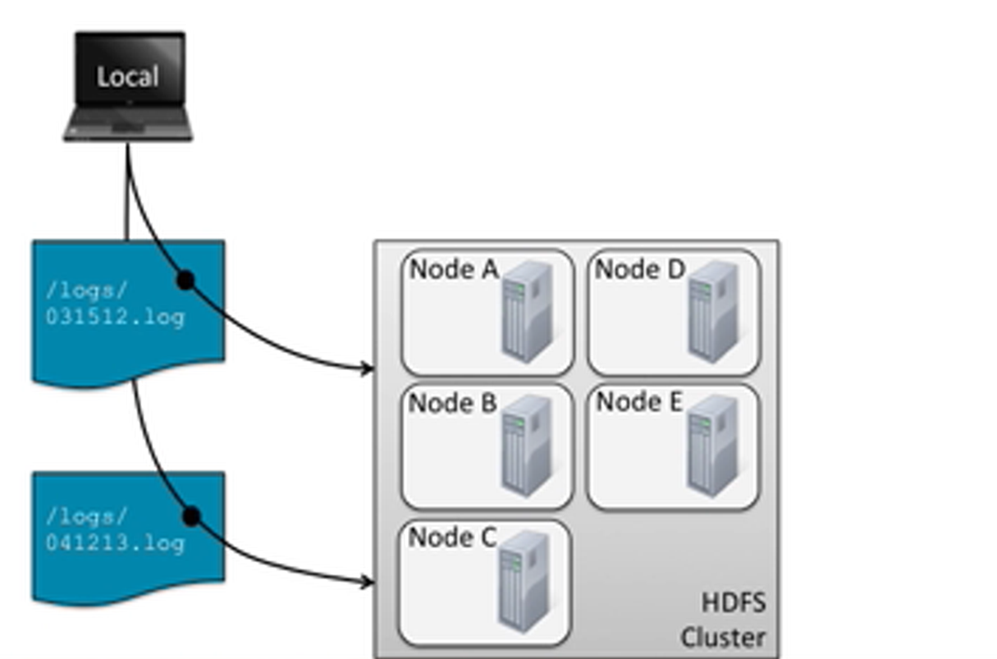
How to get data out of HDFS?

Slide 45
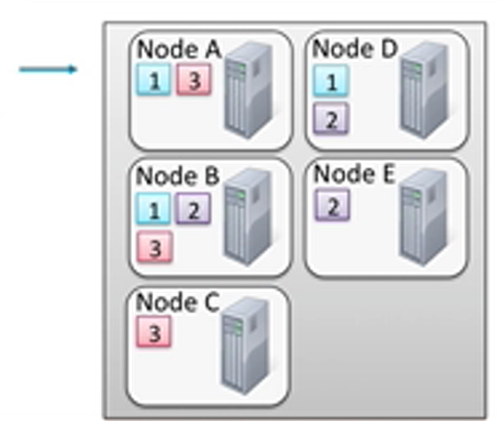
How to get data out of HDFS?

Slide 46
How to get data out of HDFS?

Slide 47
How to get data out of HDFS?

Slide 48
Distributed (Databases) Systems and Distributed (Query) Processing
The solution is

Slide 49
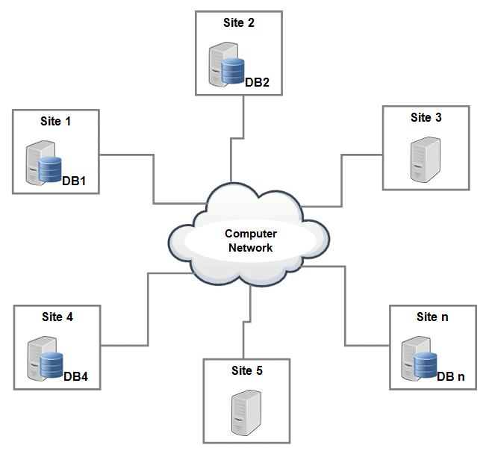
Distributed Database System

Slide 50
Distributed vs Centralised database

Slide 51
Distributed Databases
What is distributed DBs?
A distributed database is generally a database in which data is stored across different physical locations.^{[1]}
It may also be stored in multiple computers located in the same physical location (e.g. a data centre); or maybe dispersed over a network of interconnected computers.
A distributed database system consists of loosely coupled sites that share no physical components.

Slide 52
What is DDBMS?
A DDBMS (distributed database management system) is a centralized application that manages a distributed database as if it were all stored on the same computer.
The DDBMS synchronizes all the data periodically, and in cases where multiple users must access the same data, ensures that updates and deletes performed on the data at one location will be automatically reflected in the data stored elsewhere.

Slide 53
Challenges of DDBMS
Distributed DBMS is powerful and helps to solve some very important problems, But,
Introducing multiple processing units (nodes, query processing) into one architecture (thought networks) adds a lot of complexity and new types of problems
Murphy’s law of Distributing Computing: if you can have a problem (network outage), you will have a (problem) network outage.

Slide 54
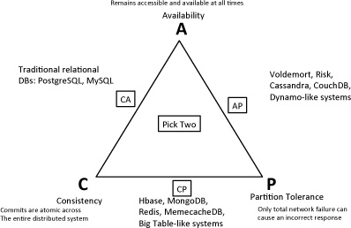
The CAP Principle

Slide 55
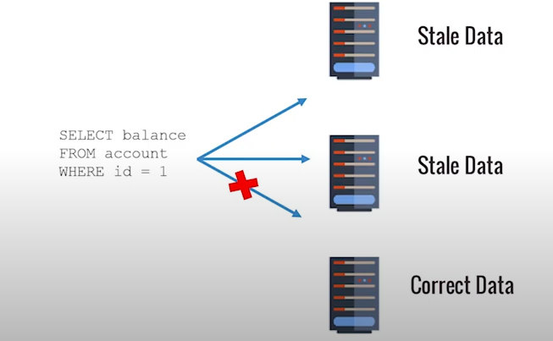
Choose between C&A
DDBMS Examples:
Checking bank balance
Number of visiting for a web page

Slide 56
Other Design Issues
How DDBMS handle network outage gracefully?
Master/Slave notes
How to handle lost node?
Should we wait to see if the node comes back?
Do we have a backup for the data?
What data was on that node anyway?
How does the application find data?
How data are updated?
Do we need to make changes in multiple places?
Are we sure all the changes were made successfully?
How do we manage locking and transactions?

Slide 57
Other Design Issues
How to execute queries on distributed data?
Push query to data
Pull data to query
How DDBs handle imbalanced data distribution?
How do we shuffling (move data between modes)?
How does the DDBMS ensure correctness?
(Select COUNT DISTINCT)
How to balance between Latency and Consistency?
How to maintain transparency?

Slide 58
Simple query will be problematic
We want count the number of users in each state.
Each node can do its calculation separately and we can sum-up at the end
We want count distinct users in our database

Slide 59
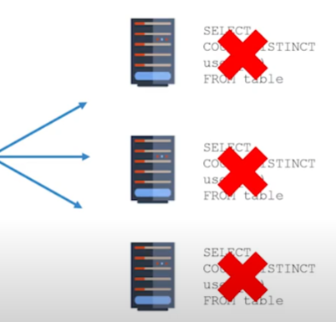
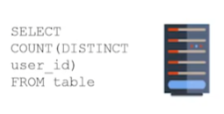
Example
Because each node only has part of the data, we cannot count distinct user in each node and add up at the end.

Slide 60
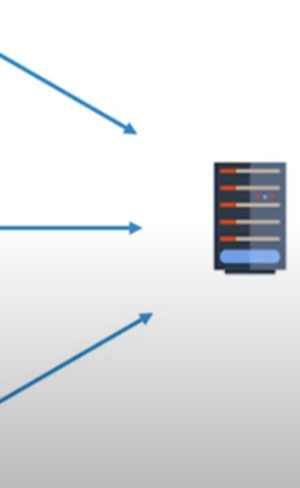
Example
Data Shuffling
Instead asking each node for count the distinct user BUT asking each node for a list of distinct users on that node. Each node will find the list and send a large list back to leader node. The leader sum up at the end

Slide 61
Two Paradigm of DDBMS
High-Availability databases (Mission-critical)
Make redundant copies of the data on different nodes
Fault tolerant-if individual nodes break or fall out of the contact, queries can still complete
Reduce dependency on any one piece of hardware
High-Consumption databases (Big-compute)
Split (or “shard”) the data across different nodes
Each node executes the query against a subset of the data
The results are combined at the end

Slide 62
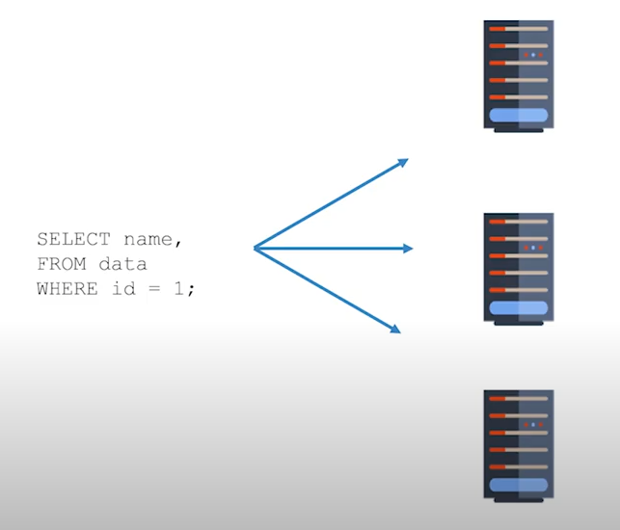
Quires processing
Query can still complete
Hard Disk Failure
Network Outage
Two down and one available the query can still be completed.

Slide 63
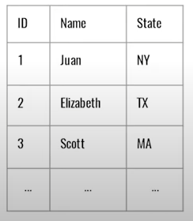
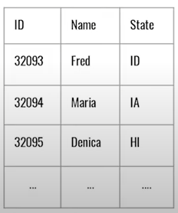
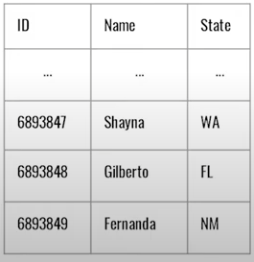
Big-Compute Databases
Data are split (shard) and stored in each node (1/3)
There is no overlapping (data are distinct)

Slide 64
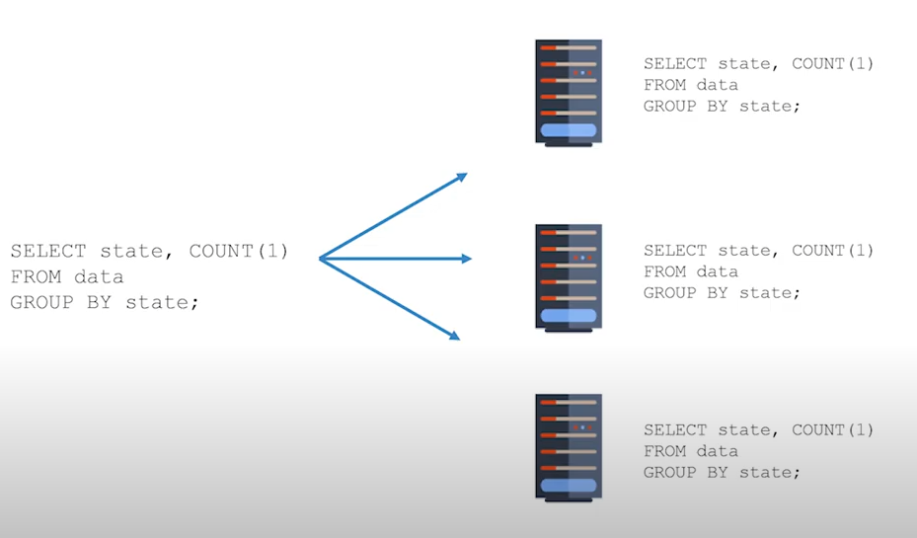
Response query by split and combine
Send the same query to each node

Slide 65
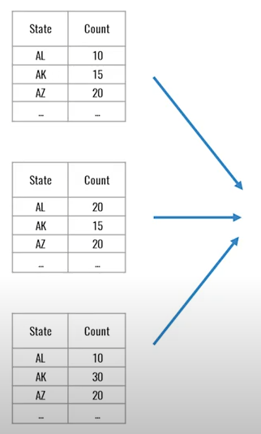
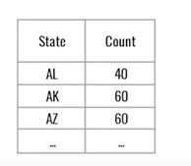
Response query by split and combine
Get results form each node
Summarise the result at the end
Get results back three time faster

Slide 66
Summary
Clouds computing provide computation and storage for data /information systems
Clouds computing: Service/Platform/Infrastructure as a service (pay as you go)
Clouds can be organised as Public/Private, Hybrid and Community clouds.
BD demand new way to store and process data.
The solution is Distributed systems. In terms of data management it refers to distributed database and distributed DBMS.

Slide 67
Summery
A distributed database (DDB) is a collection of multiple, logically interrelated databases distributed over a computer network
DDBMS manages distributed database and performs distributed (Query) processing
The data/query processing in a distributed system follows the CAP theorem because of More’s law
Challenges of DDBMS (design issues)
How DDBMS handle network outage gracefully?
How to find data?
How to process queries?
How to balance latency and consistency?
Typical Paradigms Of DDBMs
High-Availability databases (Mission-critical)
High-Consumption databases (Big-compute)

Slide 68
References:
Text Book Distributed Database Management Systems (Chapter 12)
Distributed Databases, Johann Gamper, Chapter 1: introduction

